Slide 1
Data Structures 1: Introduction, Generics, ADT Bag, Linked List, Stack

Slide 2
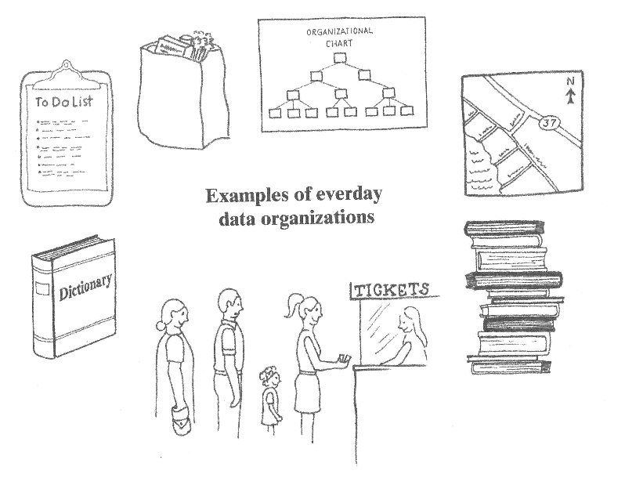
Data Structures and Collections

Slide 3
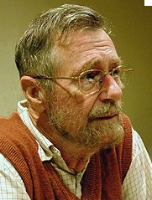
Data Abstraction
Separation of:
What can be done with of collection of data
from
How it is done
(General principle in Software Engineering:
Separation of Concerns. E. W. Dijkstra)
What - calls for a specification of an ADT
How – can be solved in a programming language such as Java

Slide 4
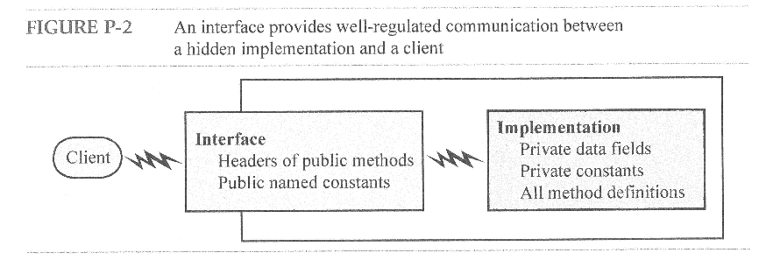
Separating What and How with a formal Interface

Slide 5
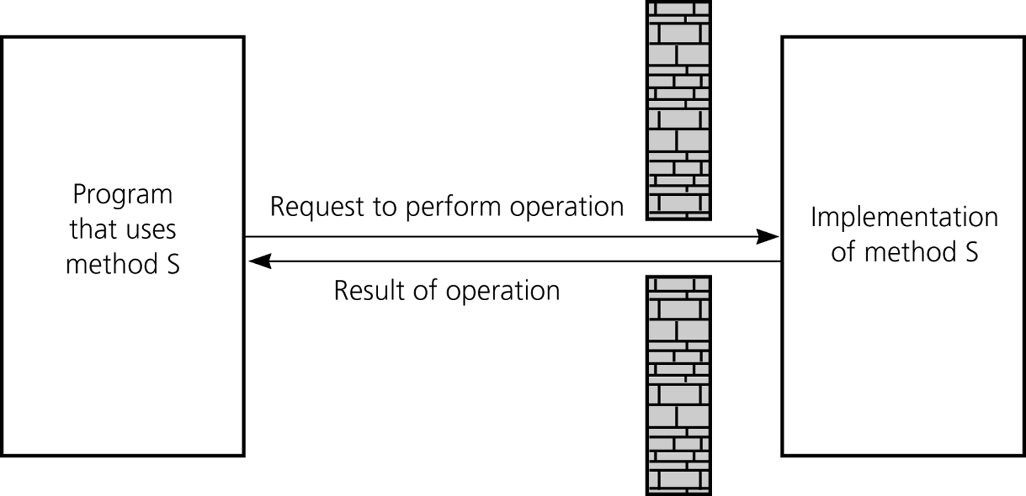
Abstract Data Types
interface
class

Slide 6
Learning Goals
Read and write (use) specifications
Select and use ADT, i.e.: List
Application
ADT
Data Structures and Algorithms
class Appl{
----
List s;
-----
s= new XXXList();
class:
ArrayList
LinkedList
----
interface:
(i.e. List)
Specification
Knowledge of
Select and use data structure, i.e. LinkedList

Slide 7
Time Complexity – Big-”O”
Investigation of the use of time and/or space of an algorithm
Normally one looks at
Worst-case (easer to determine)
Only growth rates – not exact measures
Counts the number of some “basic operations” (a computation, a comparison of to elements etc.).

Slide 8
Big-O notation:
The complexity of an algorithm is notated with “Big-O”
O(f(n)), n is the size of the problem (number of input elements, for instance), f is a function that indicates the efficiency of the algorithm, for instance n (the running time is linear in problem size)
Big-O: is asymptotic (only holds for large values of n)
Big-O: only regards most significant term
Big-O: ignores constants

Slide 9
Examples
public int sum (int a, int b){
int sum;
sum = a + b;
return sum;
}
What is the basic operation?
O(1)
What is the basic operation?
public int sum (int[] a){
int sum= 0;
for(int i= 0; i<a.length; i++)
sum= sum+a[i];
return sum;
}
O(n)

Slide 10
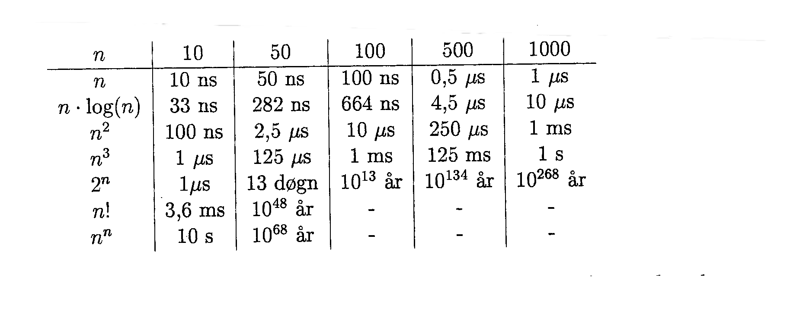
Does it matter…?
Assuming one basic operation in 1 ns
(one billion operations pr. sec. – GHz)
NOTE
It is estimated that the there are between 10⁷⁸ to 10⁸² atoms in the known, observable universe. Between ten quadrillion vigintillion and one-hundred thousand quadrillion vigintillion atoms.
“år” means “year”
“døgn” means “day”

Slide 11
A Rule of Thumb
For each nested loop the complexity must be multiplied with a factor n:
for(int i = 0; i < n; i++) O(n) {…}
for(int i = 0; i < n; i++) {
for(int j = 0; j < n; j++) O(n²) {…}
}

Slide 12
Design of ADTs
A well-designed ADT offers necessary and sufficient operations:
An ADT must offer natural and useful operations.
Operations that easily can be implemented using other operations should be omitted
This is always a balance between the complexity of the ADT and the ease of use of the ADT

Slide 13
Generics
Let a class handle types unknown at the time we write the class.
We use the generic type <T>, a placeholder for the type instead of the actual type (unknown at the time of writing).
The compiler replaces T with actual class names when T is specified

Slide 14
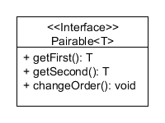
Putting it all together: Declaring an ADT in a (formal) interface using generics

Slide 15
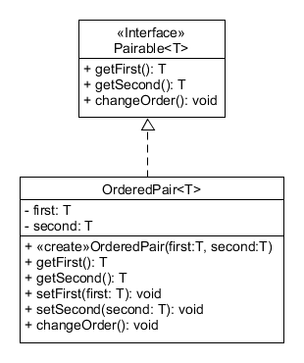
Putting it all together: The actual interface implementation

Slide 16
Important ADTs
Stack
Queue
List (also called Sequence)
Set
Map (also called Dictionary or Table)
Tree (binary or general)
Search Tree (binary or general)
Graph (or network)
They are found in most applications and model phenomenon from the problem domain

Slide 17
Definition of a Bag
A finite collection of objects.
The objects are in no particular order
They are of same or related data types
Duplicate items can exist in the bag

Slide 18
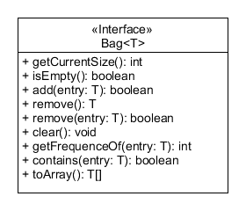
Abstract Data Type: Bag -BagInterface

Slide 19
Exercise
Implement the interfaces and implementing classes
Implement Pairable<T>
Implement OrderedPair<T>
Investigate the BagInterface project
Create a bag of Integer, add some numbers
You may add duplicates
Use the object inspector to discover the inner structure of a linked bag at runtime
Try the methods, see how they affect the object structure
Investigate the code, consider the time complexity of the add(e) and remove(e) operations
Note how we convert a collection of T to an array
(We need an instance of type T to be able to create the array because of type erasure – a non-feature of Java)
Look up the toArray method on ArrayList

Slide 20
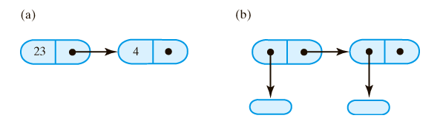
Linked Lists (LinkedList)
A linked list consists of nodes representing elements.
Each node contains a value (or value reference) and a reference (pointer) to the next element:

Slide 21
Linked Lists (LinkedList)
The list itself is represented by a reference to the first element, often called head
The next-reference of the last element is usually null
The linked list is dynamic in size: it grows and shrinks as needed.

Slide 22
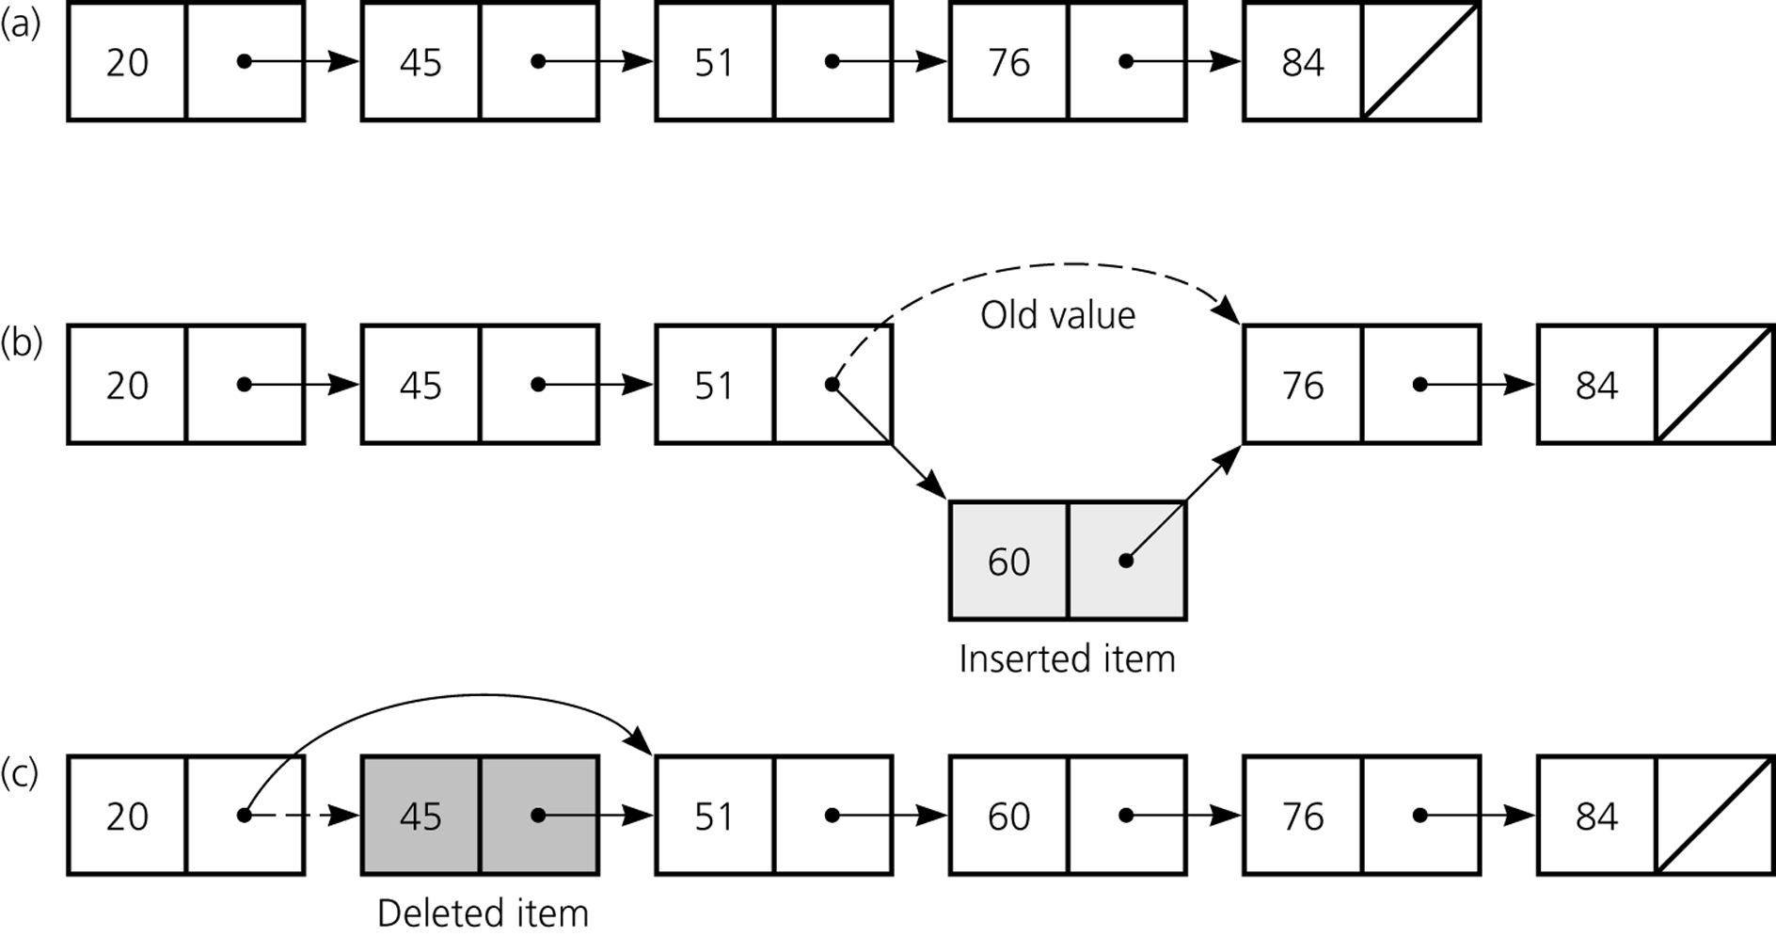
Figure 5.1
a) A linked list of integers; b) insertion; c) deletion

Slide 23
Dynamic vs. Static Data Structures
Array-Based Lists:
Fixed (static) size (waste of memory).
May be able to grow and shrink (ArrayList), but this is very expensive in running time (O(n))
Provides direct access to elements from index (O(1))
Linked List Implementations:
Uses only the necessary space (grows and shrinks as needed).
Overhead to references and memory allocation
Only sequential access: access by index requires searching (expensive: O(n))

Slide 24


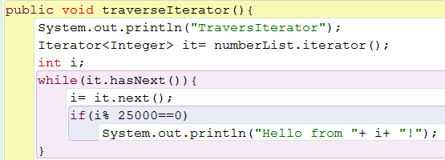
Exercise
Consider the list project again:
What is big O, if the list is an ArrayList?
What is big O, if the list is an LinkedList?

Slide 25
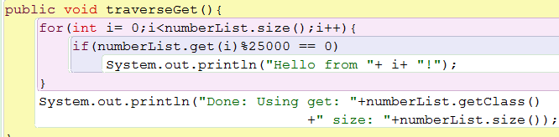
Exercise, cont…
Consider the list project again:
What is big O, if the list is an ArrayList?
What is big O, if the list is an LinkedList?

Slide 26
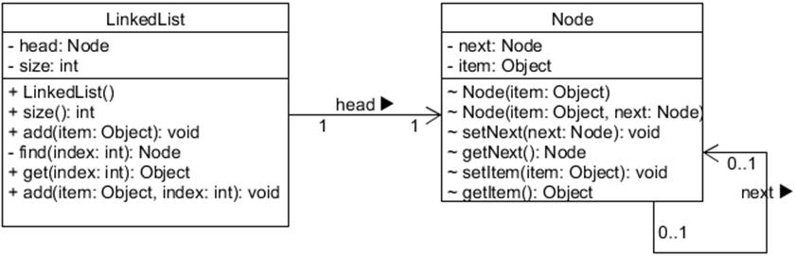
Exercise (Optional for the curious)
Consider the implementation modelled below and shown on the previous slides.
Convert it to a Generic solution
Modify the class diagram to reflect this
Implement the design
Test and debug (see how it works)

Slide 27
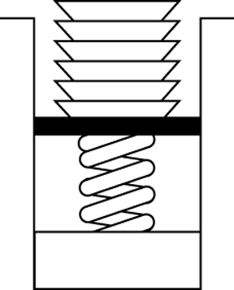
The Abstract Data Type Stack
Figure 6.1
Stack of cafeteria dishes
Stack Principle:
Elements are entered and removed from the top
(LIFO = Last In First Out).

Slide 28
ADT Stack
Operations on Stack:
Add an element to the top of the stack
void push(Object e)
Remove and return the top element from the stack
Object pop()
Check if the stack is empty
boolean isEmpty()
Read the top element without removing it
Object peek()

Slide 29
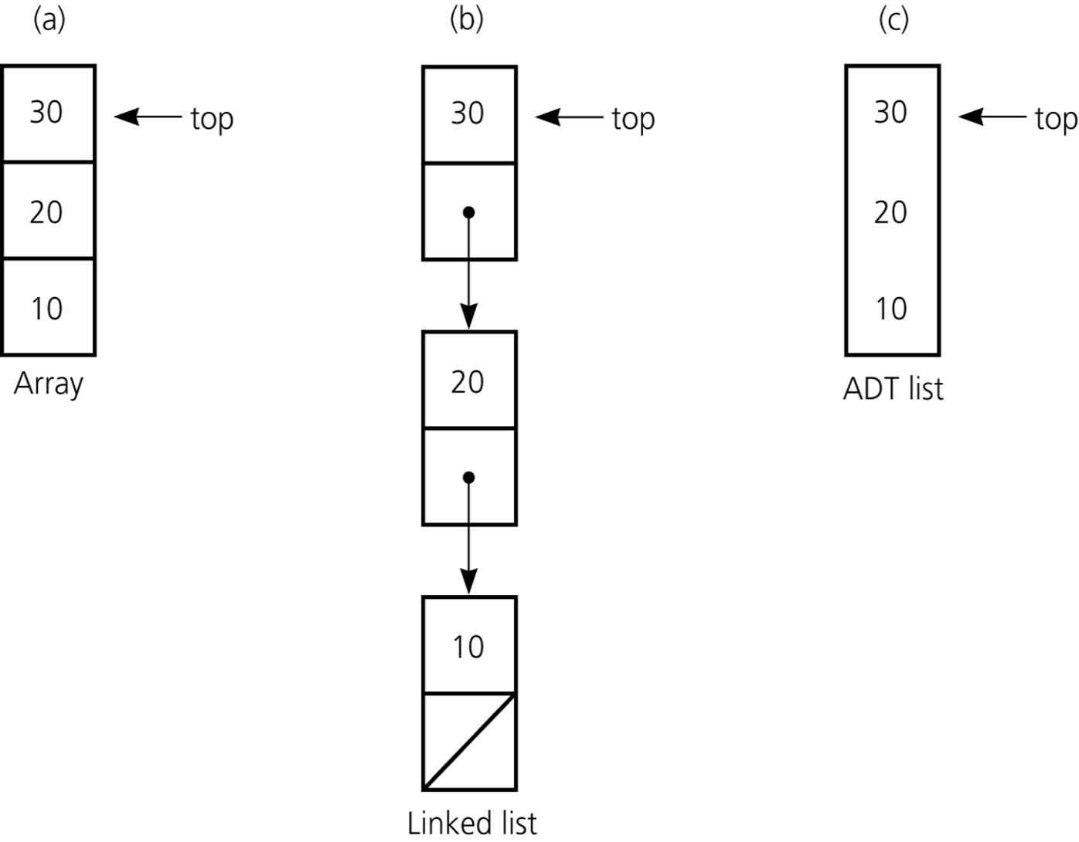
Implementation of the ADT stack that use a) an array; b) a linked list; c) an ADT list
ArrayList, for instance

Slide 30
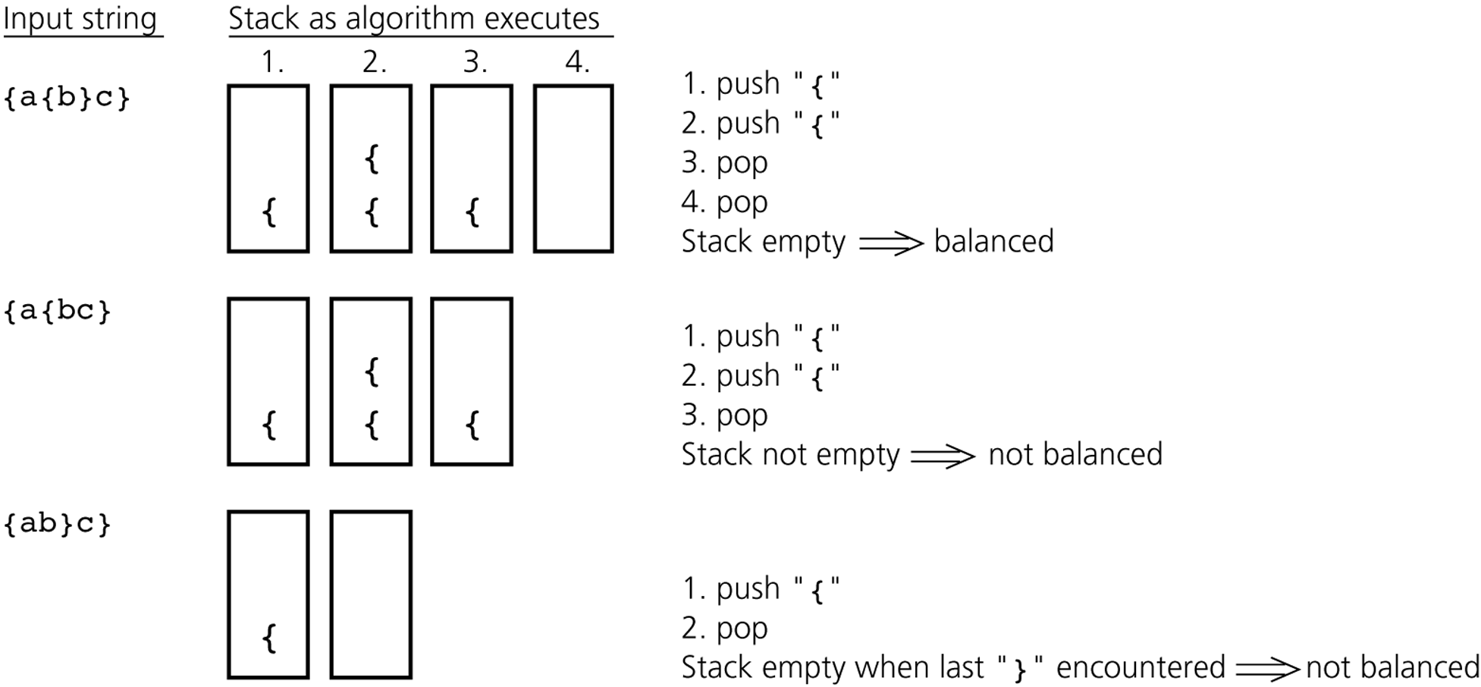
Using a Stack: Balancing Parentheses

Slide 31
Exercise
Take the bracket-balancer example from the previous slide. Implement it s.t.
BracketBalancer takes a String that contains brackets (e.g. Java source code)
It should tokenize it and pass it to a private method one character at a time
Check the possible states (1 good, 2 bad) and return a boolean (true if A-OK, false if you find a mismatch).

Slide 32
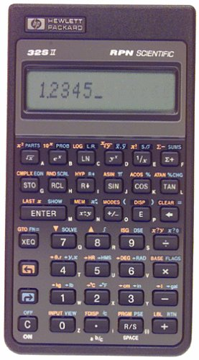

TI-32S II – A fine RPN calculator
Stack size: 4
Programmable
Physical buttons
Printed & detailed manual
An elegant weapon for a more civilized age…
32

Slide 33
Exercise (Optional…)
RPN means Reverse Polish Notation It is a postfix notation of calculations.
You’d normally write: 1 + 2 =, which would give 3.
In RPN you write 1 2 + which gives 3. The first example is infix (the operator is in-between), the second is postfix (the operator is after the operands).
Using a stack of Double it’s easy to represent a basic calculation consisting of + and -. Implement such a calculator
A more advanced version would alse multiply and divide and obey the operand sequence (/ and - : a-b != b-a).
Tips: The Rpn class should have a single method that accepts a String (a number or an operator and returns the value on the top of the stack after the input was processed. Double.valueOf(String) returns the double value of a String.

Slide 34
Exercise
Try java.util.Stack
Create a “Stack of String” instance
Push elements onto it (e.g. “a”, “b”, “c”)
Print the value that peek() returns
Print the value that pop() returns
Try java.util.Stack with a loop
Create a Stack of Integer
In a for-loop, push 10 int values onto the stack
In a while loop, using !isEmpty(), keep printing the popped values, until none are left

